Slide 1
ENEL 645 – Course Project
Fire Detection and Classification System
Aheraz Bin Muslim Mohammad
Sujesh Padhi
Abdelrahman Elnaggar
Travis Dow
Sufiyan Bukhari
Subroto Kumer Deb Nath
Winter Term – April 2023

Slide 2
Agenda
Introduction
Related Works
Materials and Methods
Results and Discussion
Conclusion

Slide 3
Introduction
History has proven large scale havoc due to fire hazards.
Causes extensive damage to the life, property, environment and the ecology.
Object detection through ML and DL proven to be effective.
YOLOv8 (You Only Look Once) is a state-of-the-art model for object detection.

Slide 4
Related Works
Fire-detection method based on image processing – April 2005
Convolutional Neural Networks Based Fire Detection in Surveillance Videos – March 2018
Convolutional Neural Networks Based Fire Detection in Surveillance Videos (using YOLOv3) – June 2020
Wildfire detection for transmission line based on improved lightweight YOLO (using version 5) – March 2023

Slide 5
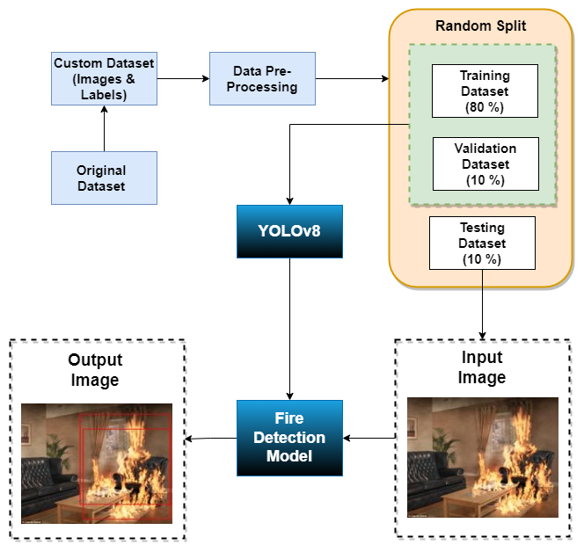


Materials and Methods
Model – YOLO v8 nano (Fastest)
Labelled fire dataset – 9462 images
Image resizing to 1280 x 1280
Center cropping
Data split – Train:Validation:Test = 80:10:10
Training for 200 epochs over fire dataset
Batch size = 8
Model 1 – Random data split, 200 epochs, NVIDIA GTX 1060
Accuracy – 64%
Model 2 – Stratified data split, 200 epochs, NVIDIA RTX 3060
Accuracy – 38%

Slide 6
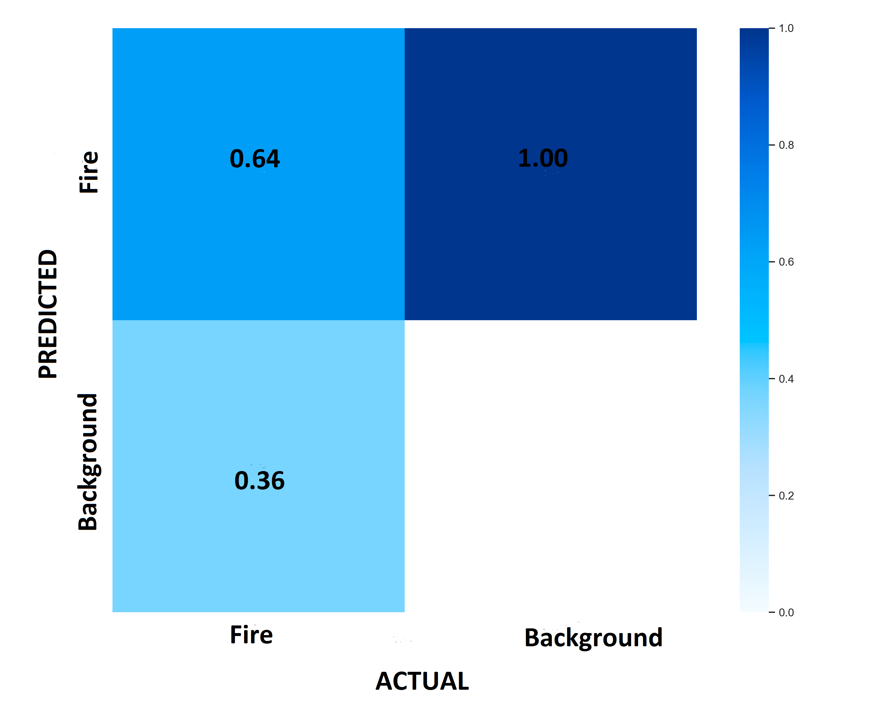
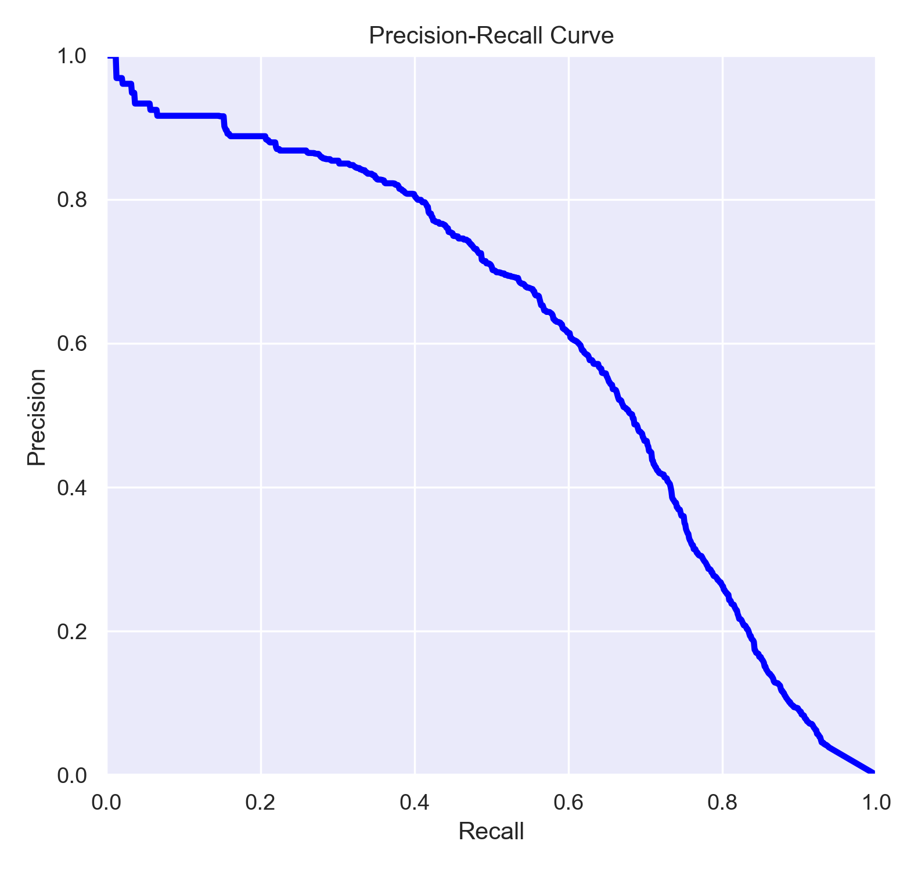
Results and Discussions – Validation Results

Slide 7
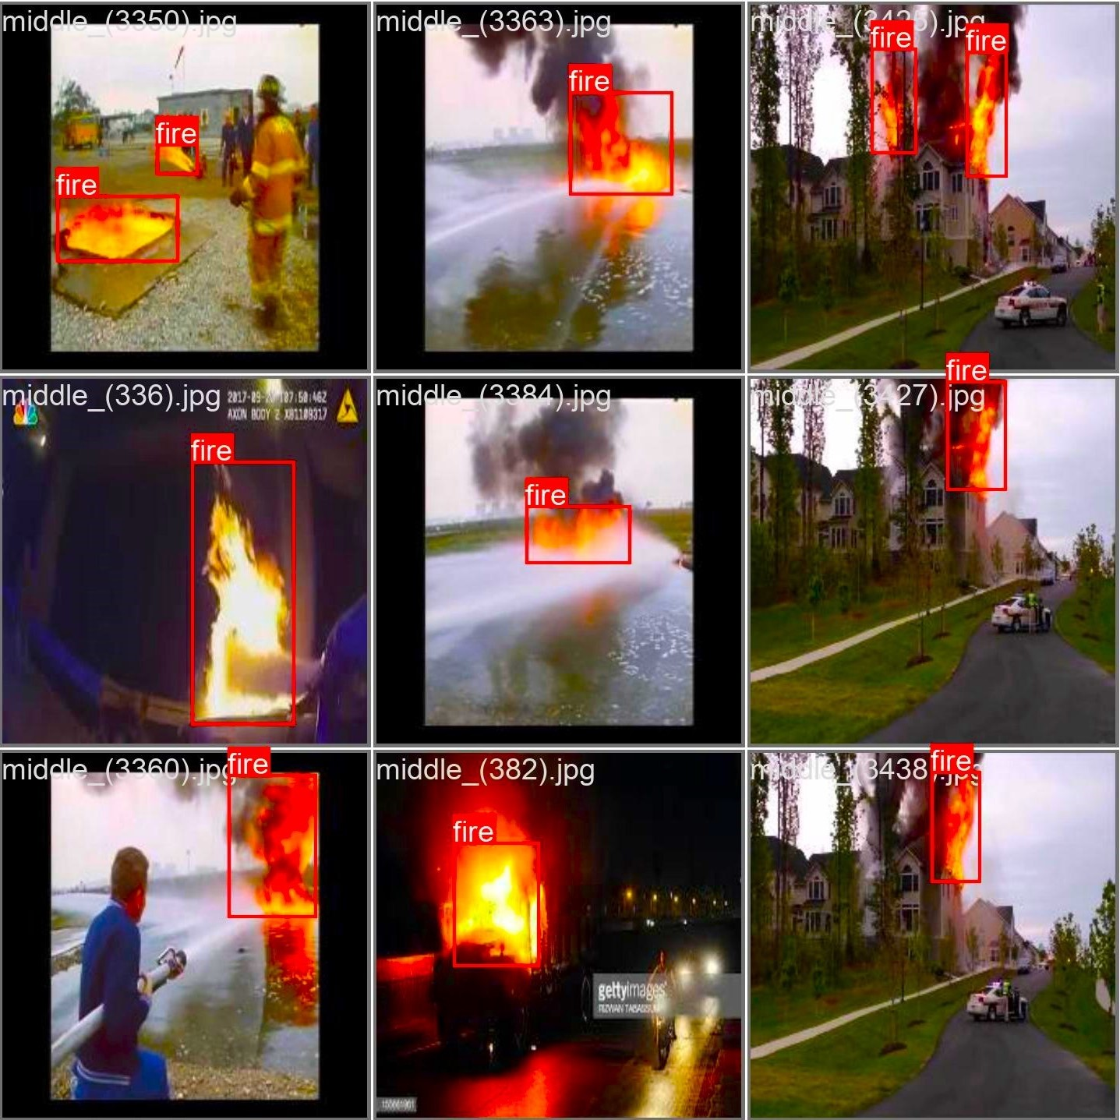
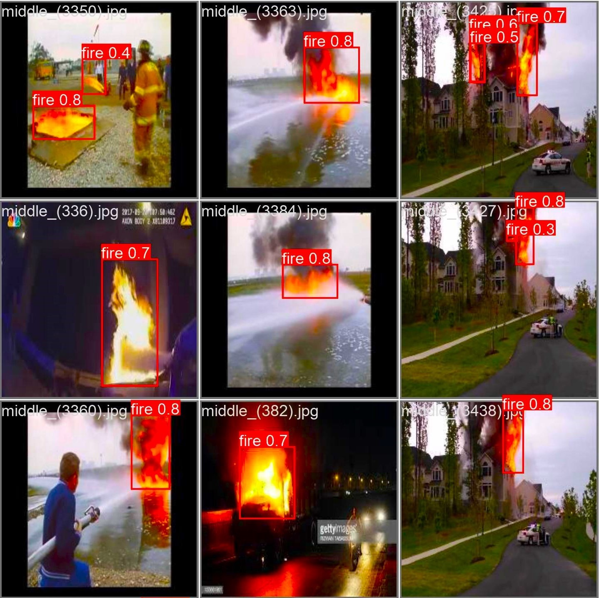
Results and Discussions – Validation Results
Actual
Predicted

Slide 8
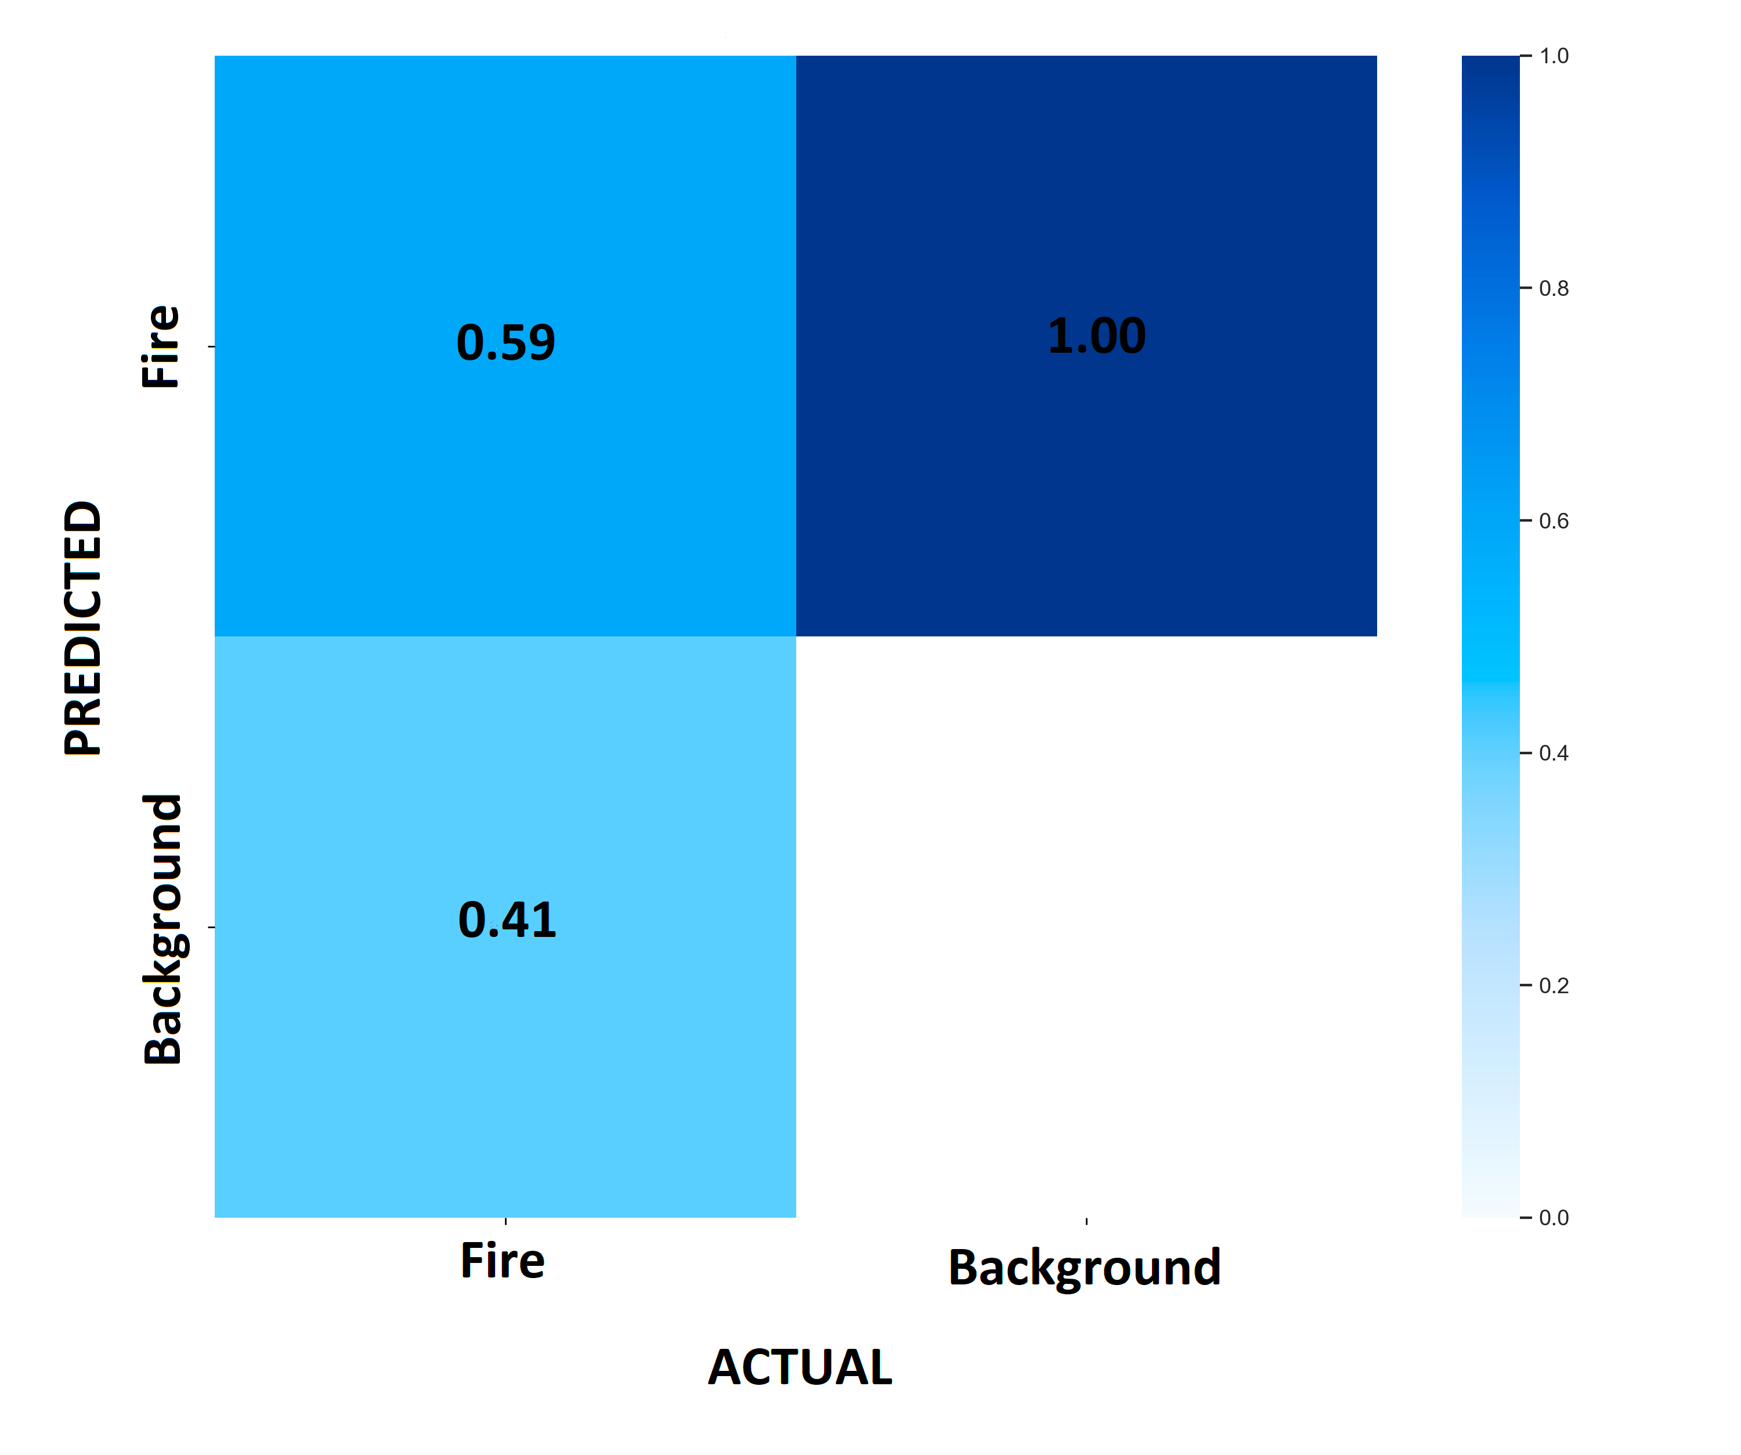
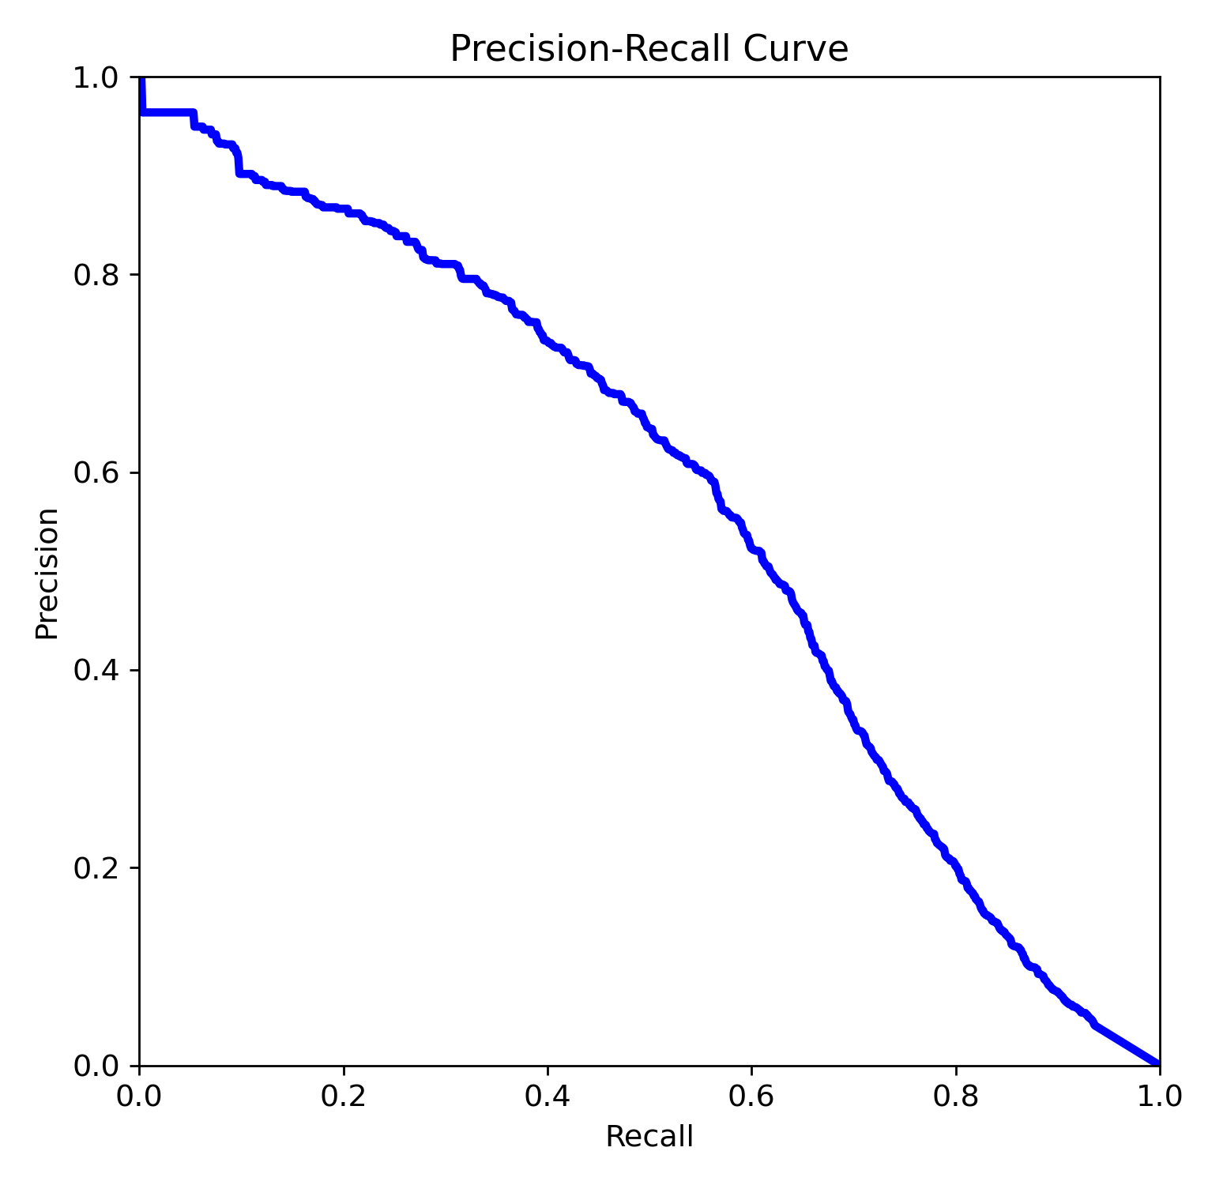
Results and Discussions – Testing Results
Slightly overfitting
Loss of 5% compared to validation results

Slide 9
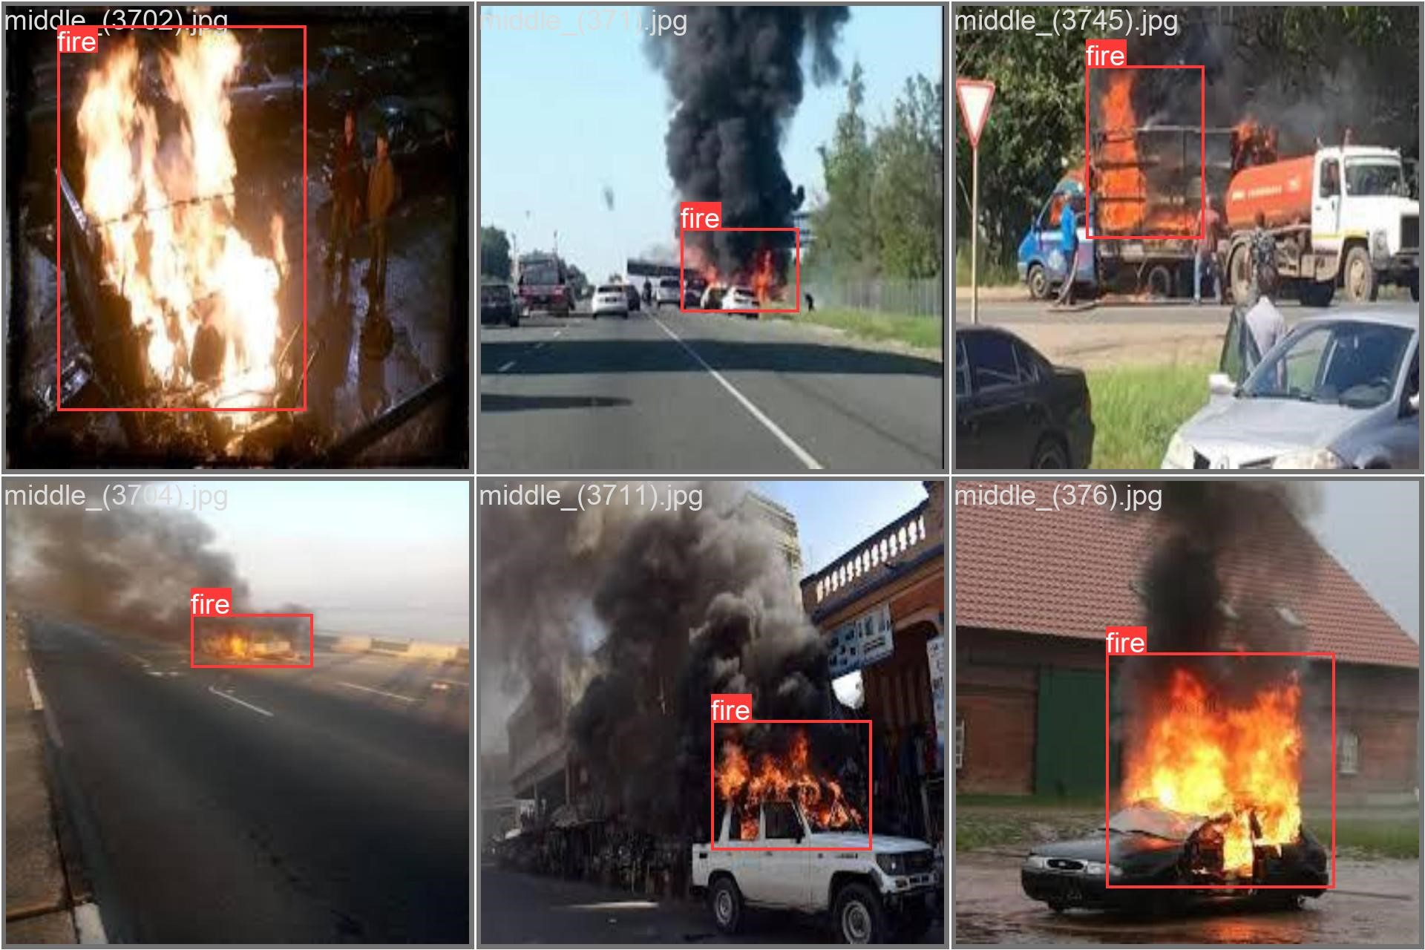
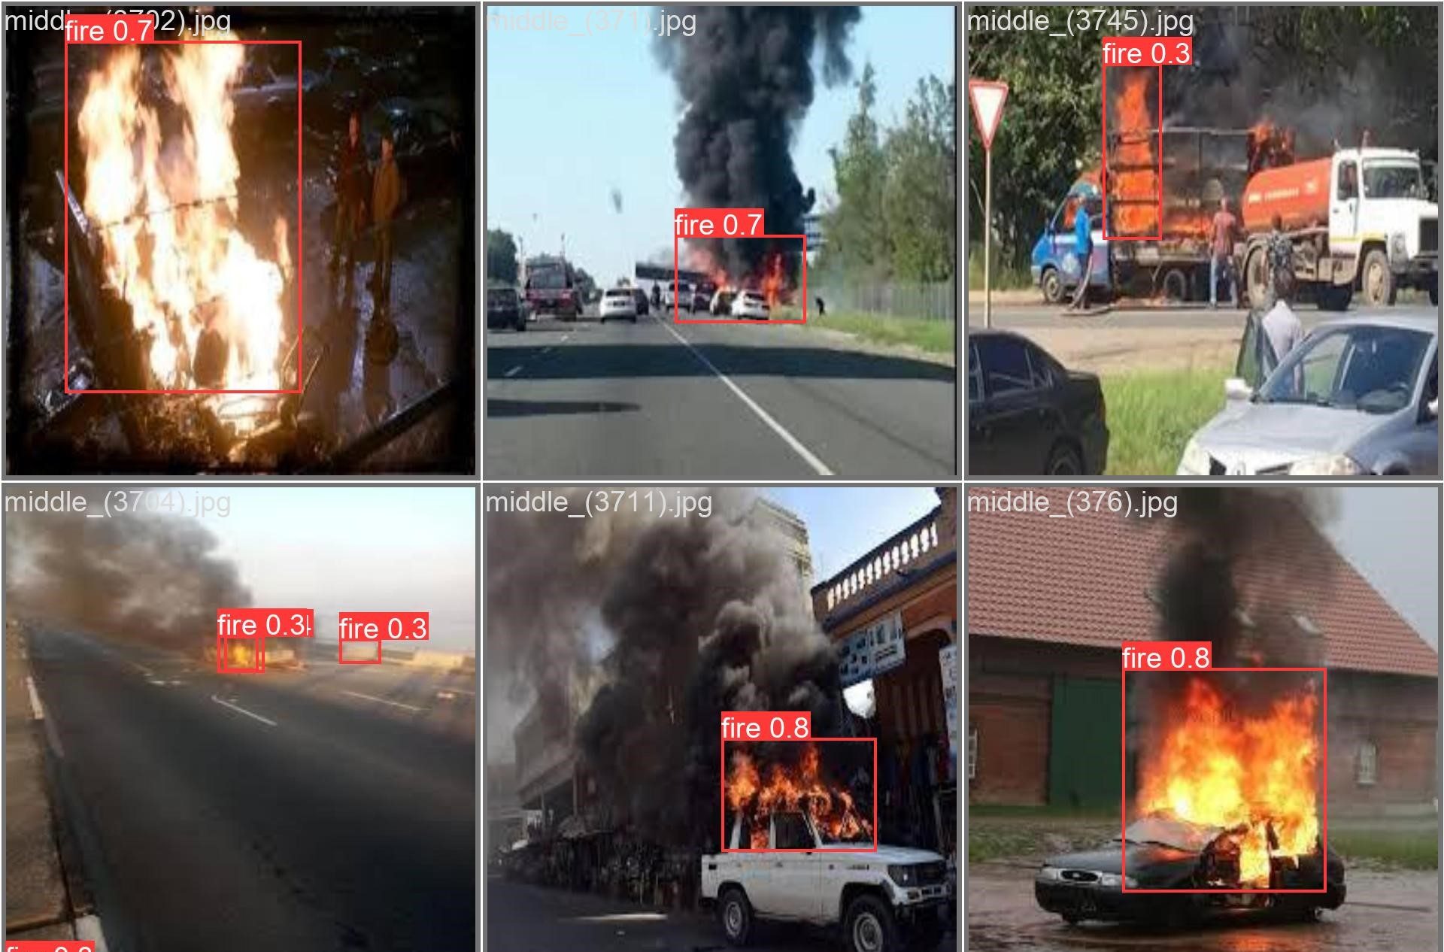
Results and Discussions – Testing Results
Actual
Predicted

Slide 10
Conclusion
We achieved an accuracy of 64% for validation and 59% for testing
Detection speeds of 23.47ms per frame (42.6 frames-per-second) using a standard GPU and 501ms per frame on a standard CPU
We successfully detected fire on a surveillance video (https://www.youtube.com/watch?v=B8NxlKMXVjU)
The overall system is light-weight, faster, and accurate and works on a non-GPU system easily
The future work tends to improve the accuracy of fire detection and to implement the system on surveillance cameras, drones, or UAV
Training and optimization with a much larger dataset for improved accuracy
Implementation in real-world scenarios to ensure its reliability and usability

Slide 11
Artefacts
GitHub Repository – https://github.com/ttdow/ENEL645
Fire Dataset Location – https://drive.google.com/file/d/1JtCrOn2jE1Pdhqru5S9oQ3KVoxECFNSL/view?usp=share_link
Presentation video – https://youtu.be/etBiSHpHKi0
Fire detection video – https://www.youtube.com/watch?v=B8NxlKMXVjU

Slide 12
Thank You

